Slide 1

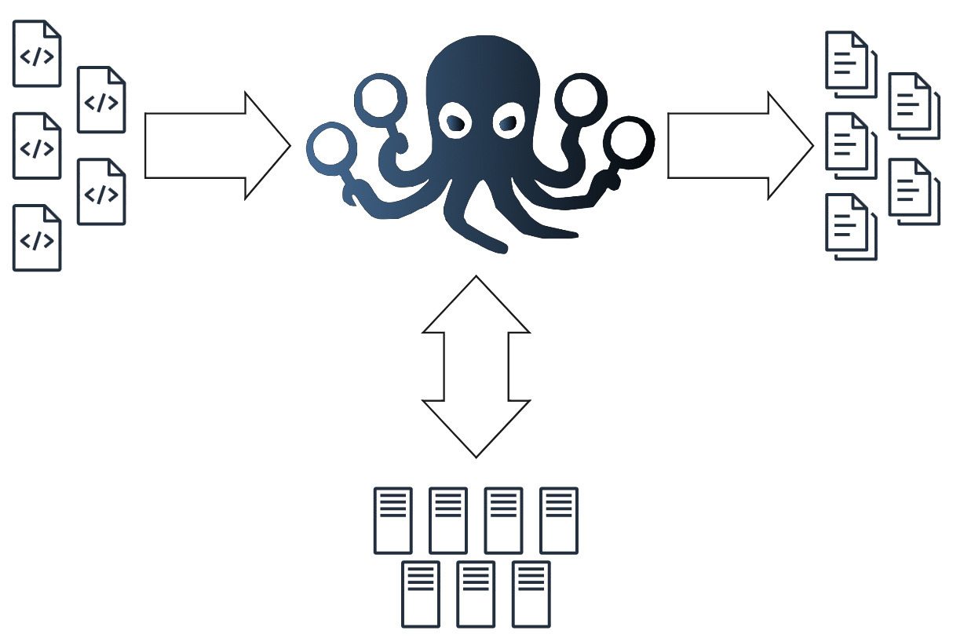



EMBArk Orchestration Framework –
Enterprise ready firmware security analysis
Built for penetration testers, developers and researchers to security test at scale
Modular orchestration of firmware analyses
Offline worker pool for parallel execution
API support for automation and integration
Firmware
Security analysis
reports
Worker pool
Notes:
security, weil keine internet verbindung
Theme: "Making IoT Security Simple"
The Hook
* "Your smart-watch, your coffee maker, your car—they all run on firmware. But
how do we know it's secure?"
* "The Internet of Things is in a state of digital chaos. We're here to bring
order."
* "Ever wondered what security holes are lurking inside the countless smart
devices you own? We can show you.
* "Built with a scalable architecture, Embark is ready to handle analysis for a
single developer or an entire enterprise."
* "Join us to see how Embark is empowering developers to build a more secure
Internet of Things for everyone."

Slide 2



Security analysis
reports
EMBArk Orchestration Framework –
Enterprise ready firmware security analysis
Notes:
Theme: "Making IoT Security Simple"
The Hook
* "Your smart-watch, your coffee maker, your car—they all run on firmware. But
how do we know it's secure?"
* "The Internet of Things is in a state of digital chaos. We're here to bring
order."
* "Ever wondered what security holes are lurking inside the countless smart
devices you own? We can show you.
* "Built with a scalable architecture, Embark is ready to handle analysis for a
single developer or an entire enterprise."
* "Join us to see how Embark is empowering developers to build a more secure
Internet of Things for everyone."

Slide 3


EMBA-verse Overview
EMBA FOSS cli tool for firmware analysis
EMBArk – Web UI for EMBA (former AMOS project)
Our work: EMBArk orchestrator – enabling parallel analysis on offline worker nodes
Notes:
EMBA cli tool – collection of shell scripts for firmware analysis

Slide 4














Analysis Workflow – From Upload to Report
Firmware Upload
User uploads Firmware via Web UI
Orchestrator queues job for analysis
Worker receives job and executes EMBA analysis
Analysis results are collected in a report
Resulting reports are collected by EMBArk
“Start analysis”
Add to queue
Assign to worker
Run analysis
Report
Notes:
User uploads via web UI
All steps with user interaction are accessible via Rest api
- Simple integration into automated workflows

Slide 5


Worker Management
Manage groups of workers in configurations
Collect status, hardware, and software information
Configure, update, reset workers
Configure / Update / Reset
192.168.1.5
192.168.1.10
192.168.1.20

